Slide 1


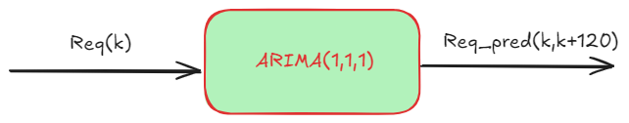
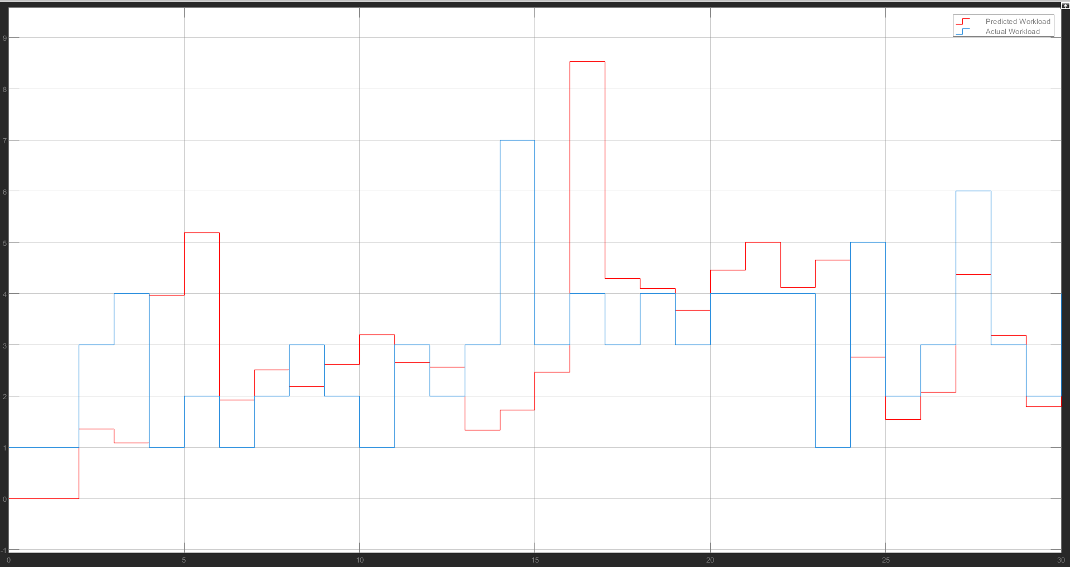
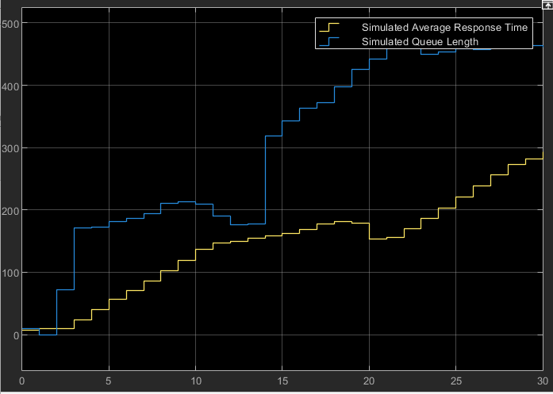
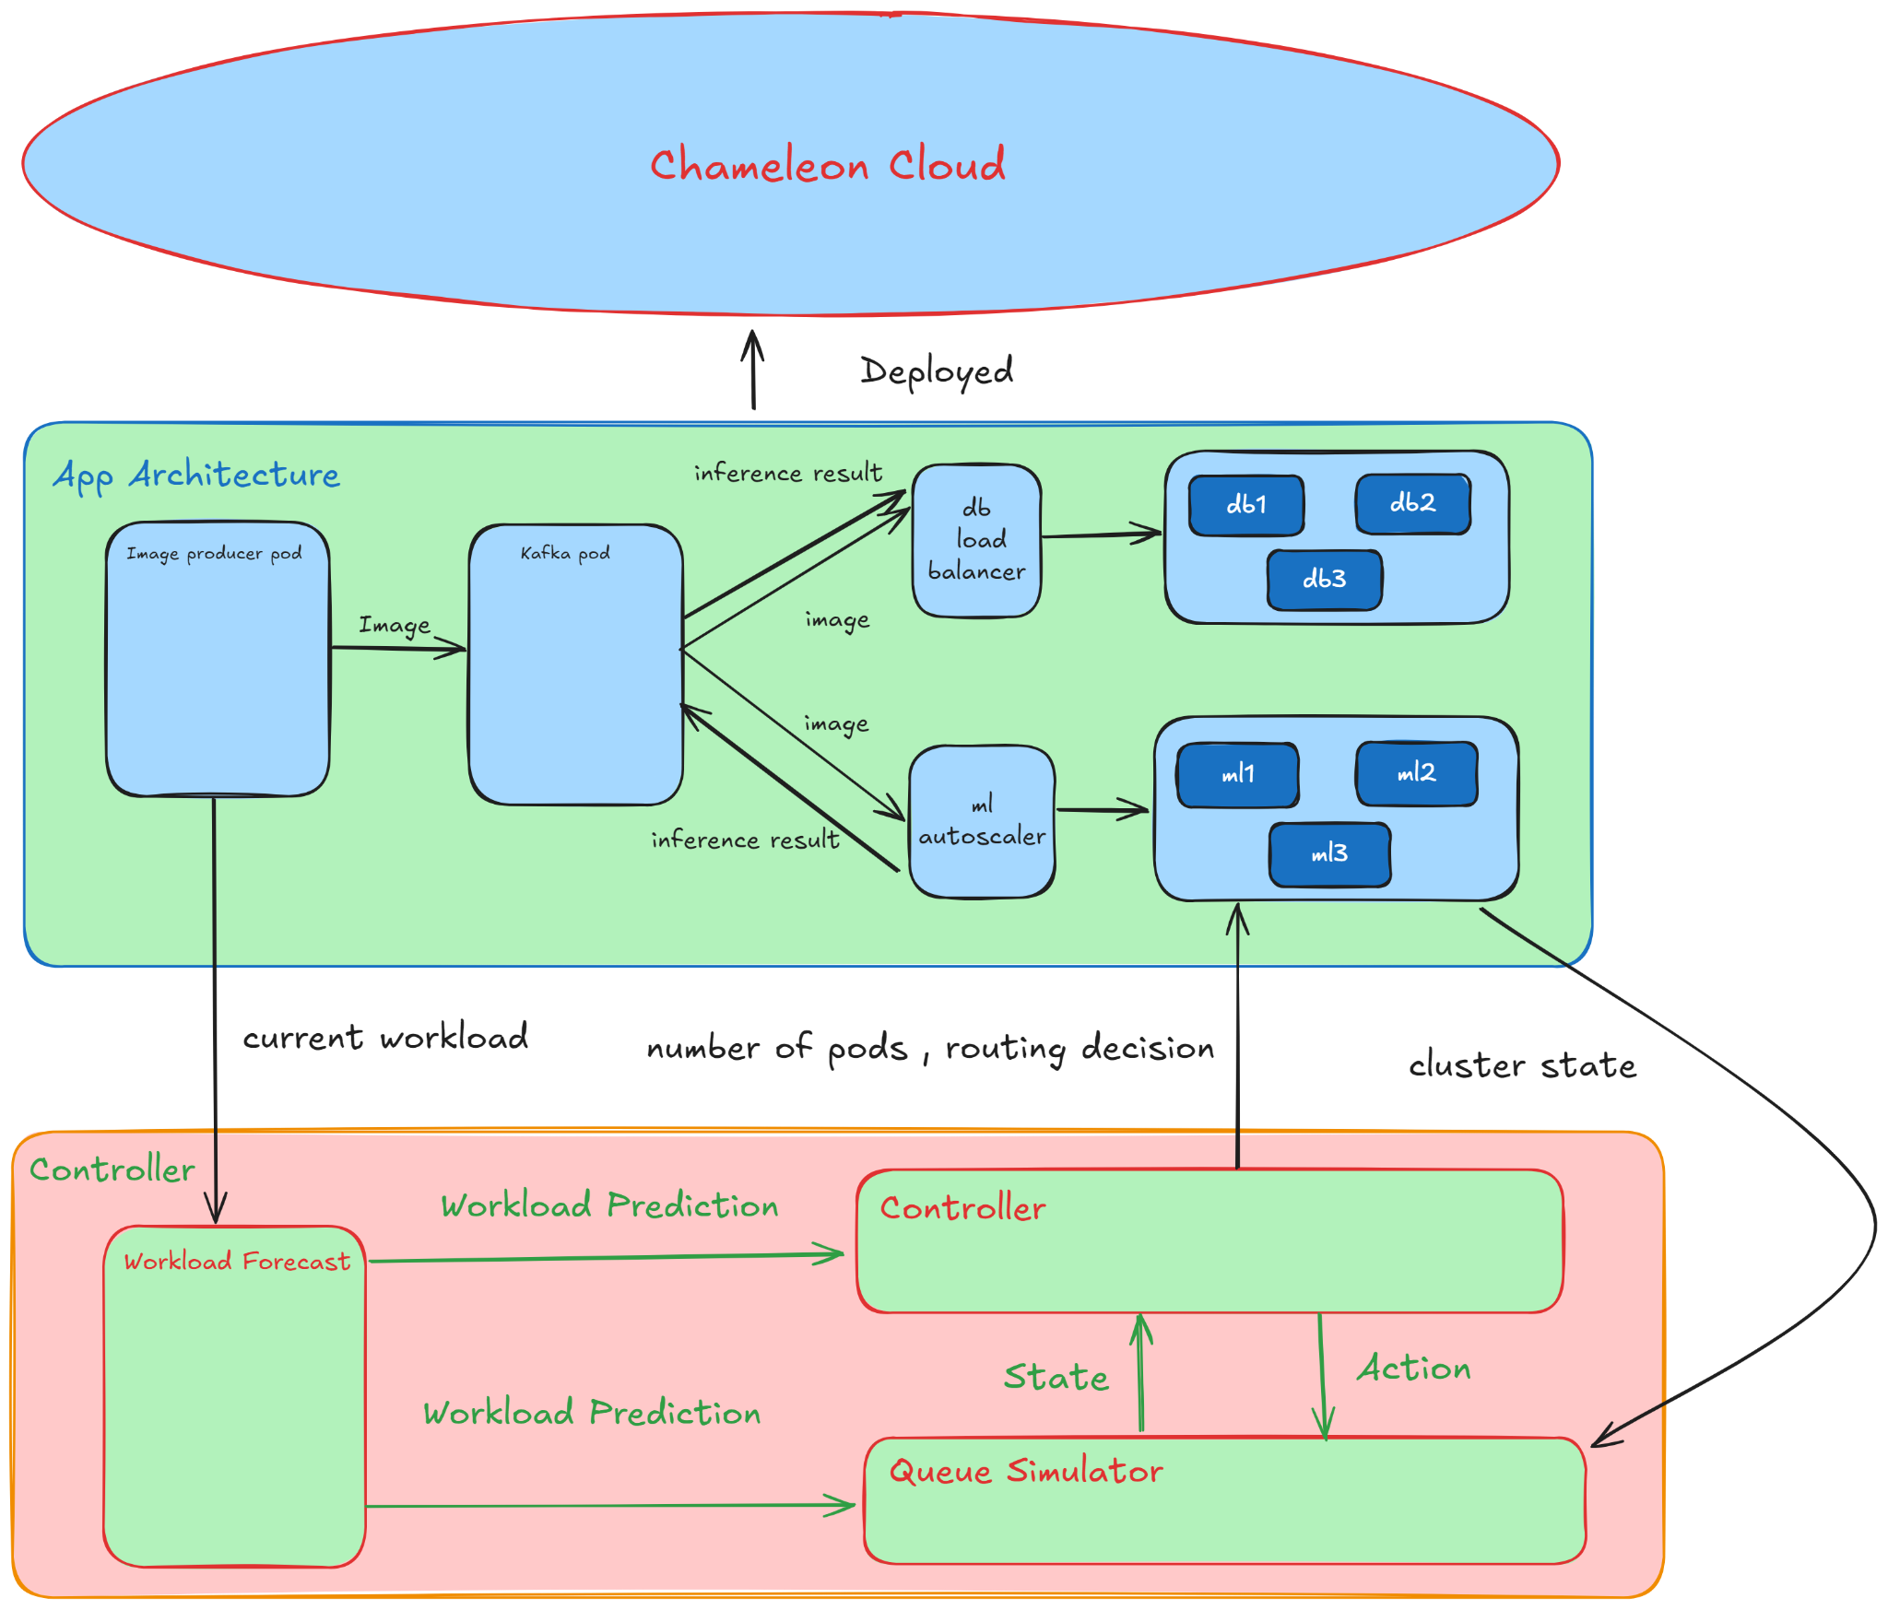
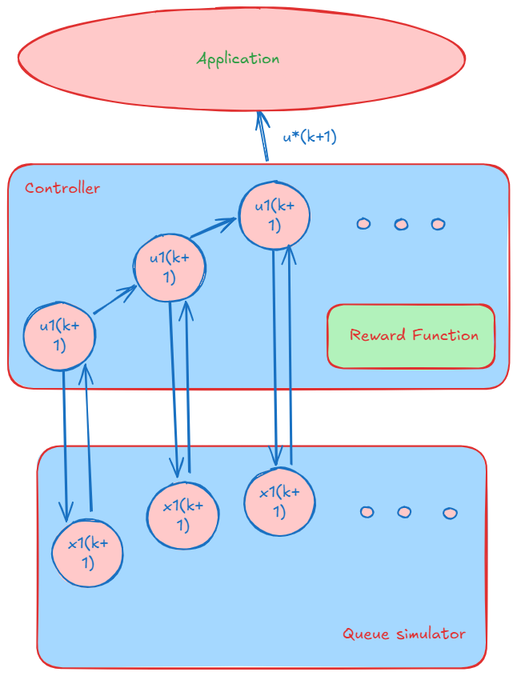
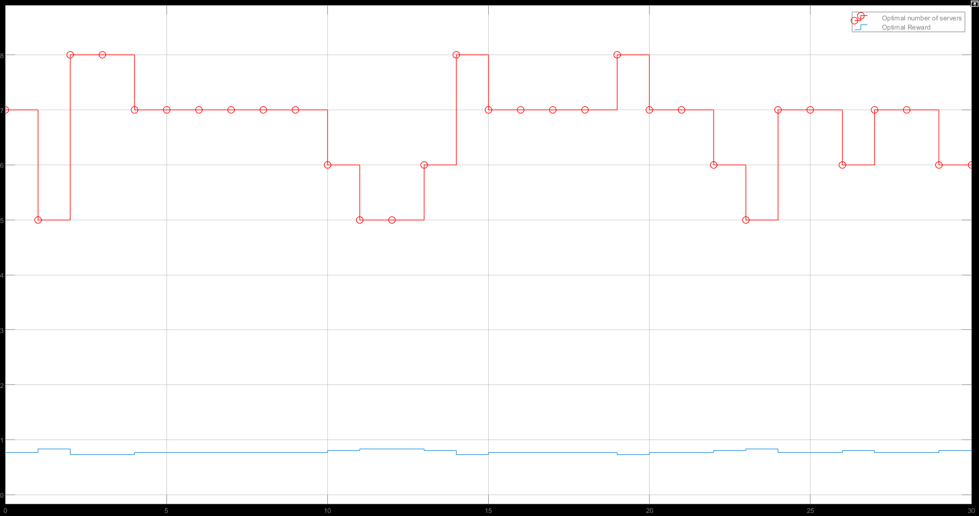
Queue-namics : Auto Scaling Through Queuing Theory
Amarnani Sparsh, Ojha Arpit, Ma Brandon
Dr. Anirudha Gokhale｜Department of Computer Science, Vanderbilt University
Z
Project Overview
Workload Forecast
Demonstration
Building an Autoscaler : Addressing the challenge of underutilized resources during low workloads and insufficient capacity during peak times with an Auto Scaling service that dynamically adjusts compute resources
A new testing framework : Developing a Simulator for AutoScaling to expedite the evaluation of different autoscaling strategies, enabling easy comparison and configuration without the need for cloud deployment.
Building our Cerberus : We introduce a three-pronged approach that includes creating a MATLAB Simevents-based simulator, modeling a cluster using M/M/C queuing theory, and proposing a novel autoscaling method informed by the model.
We use the ARIMA model to forecast, user request send per second.
We use a 1 minute forecasting window, giving us 120 values of user request.
Please look at our laptop.
Our Results
What is Autoscaling
Queue Simulator
Autoscaling is a cloud service created to address the problems of varying workloads for microservice based applications.
We utilise queuing theory , and model our clusters as M/M/C queue with a fixed serving time for request.
Autoscaler reduces underutilization during low demand periods.
They also Ensures performance standards are met during high demand.
We take inputs as arrivals, number of servers and routing decision, for the given time horizon and output the average server response time and queue length
ARIMA Forecast
Application Architecture
Controller
Our controller tries various number of servers and routing decisions with our queue simulator and evaluates their reward.
It finds the best action by evaluating them against this Reward Function :
Simulation Results
Results from our Controller

